Slide 1
Practice Session -
(568)₁₀ = ?₂ = ?₈ = ?₁₆
(568.459)₁₀ = ?₂ = ?₈ = ?₁₆
Answer
(568)₁₀ = (1000111000)₂ = (1070)₈ = (238)₁₆
(568.459)₁₀ = (1000111000.011101)₂ = (1070.353004)₈ = (238.758106)₁₆

Slide 2
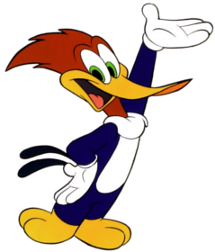



Thank You Everyone
See you in the next video
Kryptonite Lab
Coding Flow

